Slide 1
Software Requirement Specifications
Team Argus

Slide 2
Overview
Product Concept
Product Description & Functional Overview
Customer Requirements
Packaging Requirements
Performance Requirements
Safety Requirements
Maintenance & Support Requirements
Other Requirements
Acceptance Criteria
Use Cases
Feasibility Requirements
Future Items

Slide 3
Product Concept
What is it?
Data Transfer Device
Pixelsense Casino Software
Purpose and Use
Casino Chip Tracker
Device SDK
Intended Audience

Slide 4
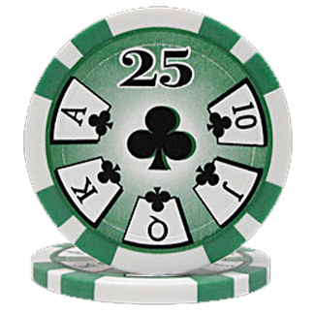

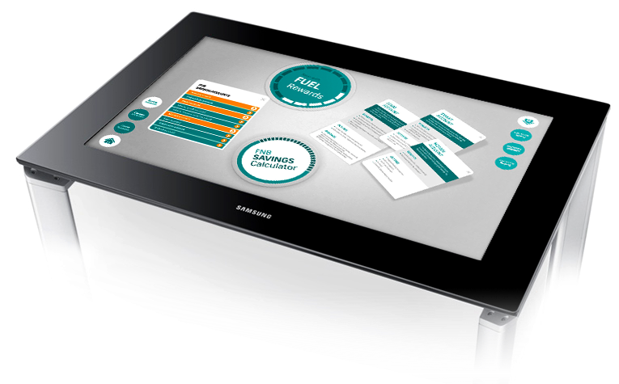
Product Description
Multi-component anti-cheating system for casinos
Consists of:
PixelSense Lynx Device Database

Slide 5
Product Description
Core Purpose:
Transfer data back and forth between the Lynx and PixelSense via light only
Why?
Avoid data interception and modification

Slide 6
Product Description
System Process
Lynx checked out to player
Player will place Lynx on table to start playing
Customer chooses desired game
Score and money are stored on Lynx and DB
Player finishes game and returns Lynx
Data is cross matched with DB for verification
Player cashes out

Slide 7
2.1 Features and Functions
Core Features:
View data on tablet/computer
Optical communication between PixelSense and Lynx
All transactions are backed up to an external server
Lynx should be automatically detected by app
All communication should be done locally, optically or hardlined

Slide 8
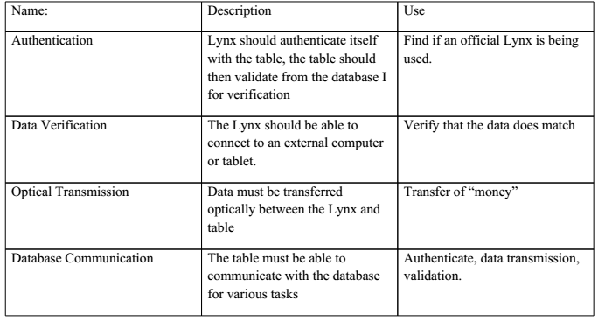
2.1 External Input and Outputs
No direct communication
between user and Lynx
2-Way communication
between Lynx and
PixelSense
External Database
connection
Serial output to tablet

Slide 9
4. Packaging Requirements
4.1 Attachable to Tablet
4.1.1 Description: The Lynx must be attachable and detachable physically from the tablet it is connected to. This is referring to a mechanism so the Lynx can physically stay on the tablet it is connected to, not the serial connection with the cord plugged into the tablet.
4.1.2 Source: Dr. Zaruba
4.1.3 Constraints: The Lynx will only attachable/detachable for the one tablet we chose to develop on. (Only referring to the mechanism to keep the Lynx physically attached to the tablet, not the serial connection with the cord plugged into the tablet.)
4.1.4 Standards: None
4.1.5 Priority: 3 - Moderate

Slide 10
4. Packaging Requirements
4.2 Device Assembled
4.2.1 Description: The Lynx will be assembled and ready for use.
4.2.2 Source: Dr. Zaruba
4.2.3 Constraints: None
4.2.4 Standards: None
4.2.5 Priority: 4 – High

Slide 11
4. Packaging Requirements
4.3 Lynx as a Tablet Case
4.3.1 Description: The Lynx will serve as a tablet case for the tablet we chose to develop for.
4.3.2 Source: Dr. Zaruba
4.3.3 Constraints: Case will only fit the tablet we chose to develop for.
4.3.4 Standards: None
4.3.5 Priority: 2 – Low

Slide 12
4. Packaging Requirements
4.4 SDK on USB Flash Drive
4.4.1 Description: The Lynx’ SDK for the PixelSense table, the Secure Transfer Device, and the connected device will be provided on a USB flash drive for use on Windows.
4.4.2 Source: Dr. Zaruba
4.4.3 Constraints: None
4.4.4 Standards: None
4.4.5 Priority: 4 – High

Slide 13
4. Packaging Requirements
4.5 PixelSense Casino Software
4.5.1 Description: The PixelSense casino software will be provided on a USB Flash Drive which can be used to install the software on the PixelSense table.
4.5.2 Source: Dr. Zaruba
4.5.3 Constraints: None
4.5.4 Standards: None
4.5.5 Priority: 4 – High

Slide 14
4. Packaging Requirements
4.6 PC Casino Companion Software
4.6.1 Description: The PC Casino Companion Software will be packaged as an executable file on an USB Flash Drive that can be used on compatible Windows PCs.
4.6.2 Source: Dr. Zaruba
4.6.3 Constraints: None
4.6.4 Standards: None
4.6.5 Priority: 4 – High

Slide 15
4. Packaging Requirements
4.7 Android Casino Software
4.7.1 Description: The Android Casino Software will be packaged in an APK on an USB Flash Drive that can be installed on compatible Android tablets.
4.7.2 Source: Dr. Zaruba
4.7.3 Constraints: None
4.7.4 Standards: None
4.7.5 Priority: 4 – High

Slide 16
5. Performance Requirements
Core Performance Components
Optical Transfer
Data Translation
Connection Times
Authentication Times
Software Boot Times
Data r/w

Slide 17
5. Performance Requirements
5.1 Minimum Data Transfer Rate
5.1.1 Description: Data transfer must be consistent at minimum of 200 bits/sec
5.1.2 Source: Dr. Zaruba
5.1.3 Constraints: PixelSense refresh rate is between 30-60Hz, this must be kept in mind
5.1.4 Standards: None
5.1.5 Priority: 4 – High

Slide 18
5. Performance Requirements
5.2 Data Translation
5.2.1 Description: Converting optical data to binary data for later readability should be at most 1 second.
5.2.2 Source: Team Argus
5.2.3 Constraints: None
5.2.4 Standards: None
5.2.5 Priority: 3 – Moderate

Slide 19
5. Performance Requirements
5.3 Authentication Time
5.3.1 Description: The Lynx should not take too long to authenticate its integrity with the PixelSense. Time should at most 5 seconds.
5.3.2 Source: Dr. Zaruba
5.3.3 Constraints: Must be 2-Way authentication
5.3.4 Standards: None
5.3.5 Priority: 3 – Moderate

Slide 20
5. Performance Requirements
5.4 Software Boot Times
5.4.1 Description: Software should not take a long time to boot and load data. Ideally this should be less than 10 seconds.
5.4.2 Source: Team Argus
5.4.3 Constraints: PixelSense processing power as well as concurrent PixelSense background processes
5.4.4 Standards: None
5.4.5 Priority: 4 – High

Slide 21
5. Performance Requirements
5.5 Data Read/Write Times
5.5.1 Description: Reading and writing data to the Lynx should be at most 1 second.
5.5.2 Source: Team Argus
5.5.3 Constraints: Depends on microcontroller speed
5.5.4 Standards: None
5.5.5 Priority: 4 – High

Slide 22
5. Performance Requirements
5.6 Battery Life
5.6.1 Description: Battery Life on the Lynx should last about half a casino day which is about 8 hours.
5.6.2 Source: Team Argus
5.6.3 Constraints: None
5.6.4 Standards: None
5.6.5 Priority: 4 – High

Slide 23
5. Performance Requirements
5.7 Overall Connection Times
5.7.1 Description: Connection times to the Lynx, tablet and DB should take no longer than 5 seconds from each other.
5.7.2 Source: Dr. Zaruba
5.7.3 Constraints: Network speed and hardware transmission limitations
5.7.4 Standards: None
5.7.5 Priority: 3 – Moderate

Slide 24
6. Safety Requirements
Core Safety
Protect system and devices
Protect end-user

Slide 25
6. Safety Requirements
6.1 No Sharp Edges
6.1.1 Description: Lynx must not have any sharp edges
6.1.2 Source: Team Argus
6.1.3 Constraints: None
6.1.4 Standards: None
6.1.5 Priority: 4 – High

Slide 26
6. Safety Requirements
6.1 Protective Case Around Lynx
5.6.1 Description: Lynx should have a protective case to prevent exposure to liquids
5.6.2 Source: Team Argus
5.6.3 Constraints: None
5.6.4 Standards: None
5.6.5 Priority: 4 – High

Slide 27
7. Maintenance & Support Requirements
User Manual
It shall include step by step guide to use the SDK with device & software on Surface Table.
Priority: 4 - High
Software Installation
Software will be provided to interact between device and PixelSense Table. Should work on Windows 7.
Priority: 5 - Very High

Slide 28
7. Maintenance & Support Requirements
Source Code / SDK
Source code shall be provided to the customer as final deliverable. Basic Software Development Kit shall be provided for future developments.
Priority: 3 - Moderate
Hardware Support
Device (Lynx) shall be ready to use on any PixelSense Table running Windows 7. Device shall be replaceable with same application.
Priority: 5 - Very High

Slide 29
Acceptance Criteria
9.1 The device can securely transfer information to the PixelSense table using an array of sensors
9.1.1 Requirement(s) addressed: Requirement 3.1 - Send Data Optically.
9.1.2 Verification Procedure: The customer will use the software provided for the PixelSense table and the tablet connected to the Lynx to verify that the table can receive information from the tablet connected to the Lynx. All other forms of communications will be turned off on both the tablet and the table to insure that the Lynx alone was transmitting the information.

Slide 30
Acceptance Criteria
9.2 The device can securely receive information from the PixelSense table using an array of sensors
9.2.1 Requirement(s) addressed: Requirement 3.2 - Box Color: Read Data Optically.
9.2.2 Verification Procedure: The customer will use the software provided for the PixelSense table and the tablet connected to the Lynx to verify that the table can send information to the tablet connected to the Lynx. All other forms of communications will be turned off on both the tablet and the table to insure that the Lynx alone was transmitting the information.

Slide 31
Acceptance Criteria
9.3 An SDK is provided that can be used to program for the device created
9.3.1 Requirement(s) addressed: Requirement 3.3 - All work done by the product involving optical communication should be compiled into a well documented library
9.3.2 Verification Procedure: The customer will be given the code used to create the secure connection between the table and the Lynx, as well as any documentation created for the Lynx, and verify whether or not the resources provided are sufficient enough to create an application using the Lynx and the table.

Slide 32
Acceptance Criteria
9.4 The transfer rate of the Lynx is at least 200 bits/sec
9.4.1 Requirement(s) addressed: Requirement 5.1 – Minimum Transfer Rate
9.4.2 Verification Procedure: The customer will use the software developed for the Lynx and the table, as well as any tools the customer deems necessary, to verify the Lynx satisfies the minimum data transfer throughput requirements.

Slide 33
Acceptance Criteria
9.5 The Lynx has a port that can be used to connect to a tablet
9.5.1 Requirement(s) addressed: Requirement 3.4 – Device must have a serial port.
9.5.2 Verification Procedure: The customer will use the port on the Lynx and verify that when an Android tablet is connected to it, the Android tablet can transfer data through the Lynx using the software provided.

Slide 34
Acceptance Criteria
9.6 The software is provided for the PixelSense table that demonstrates the connection between the Lynx and the table
9.6.1 Requirement(s) addressed: Requirement 3.7 – Software will be built to show optical transfer protocol.
9.6.2 Verification Procedure: The customer will use the casino software provided and verify that is demonstrates the secure connection between the Lynx (with the tablet connected to it) and the PixelSense table. The customer will do this using the software provided for the PixelSense table, as well as the software for the tablet connected to the secure transfer Lynx.

Slide 35
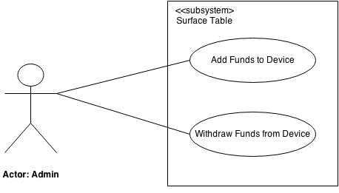
10.1 Use Case <<Microsoft Surface Table subsystem>>

Slide 36
10.1 Use Case <<Microsoft Surface Table subsystem>>
Add Funds to Lynx
Actor: Admin
TUCBW Admin enters User ID into the system and click “Add Funds” button.
TUCEW Admin sees the confirmation of funds being added to the Lynx.
Add Funds to Lynx
Actor: Admin
TUCBW Admin enters User ID into the system and click “Add Funds” button.
TUCEW Admin sees the confirmation of funds being added to the Lynx.

Slide 37
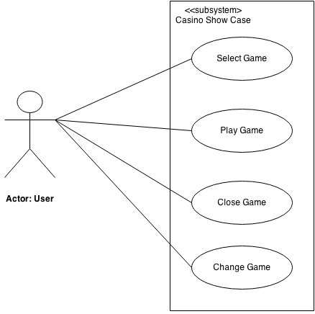
10.2 Use Case <<Casino Showcase subsystem>>

Slide 38
10.2 Use Case <<Casino Showcase subsystem>>
Select Game
Actor: User
TUCBW User taps Game Icon from Available Games on the screen.
TUCEW User sees the Game opened which he/she tapped.
Play Game
Actor: User
TUCBW User places the Lynx on the ‘Lynx spot’ of the game.
TUCEW User sees the message ‘Access Granted with Lynx’ with his/her details & funds.

Slide 39
10.2 Use Case <<Casino Showcase subsystem>>
Close Game
Actor: User
TUCBW User selects ‘Exit’ Button from the current game.
TUCEW User sees the Casino Showcase game selection Screen.
Change Game
Actor: User
TUCBW User selects ‘Exit’ Button from the current game.
TUCEW User selects a new game from the game selection screen.

Slide 40
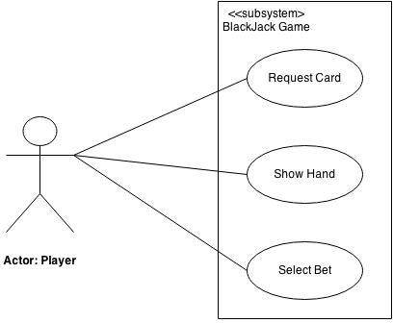
10.3 Use Case <<Blackjack Game subsystem>>

Slide 41
10.3 Use Case <<Blackjack Game subsystem>>
Request Card
Actor: Player
TUCBW Player presses ‘Hit’ button on the screen.
TUCEW Player sees the card opened in his/her area.
Show Hand
Actor: Player
TUCBW Player presses ‘Stand’ Button on the screen.
TUCEW Player sees the card of dealer opened in Dealer Area.

Slide 42
10.3 Use Case <<Blackjack Game subsystem>>
Select Bet
Actor: Player
TUCBW Player selects the chips from chip symbol to ‘Bet Area’.
TUCEW Player sees the final amount of selected Bet Amount.

Slide 43

Questions?

